Slide 1
Chapter 4 – Requirements Engineering
Lecture 1

Slide 2
Requirements engineering
The process of establishing the services that the customer requires from a system and the constraints under which it operates and is developed.
The requirements themselves are the descriptions of the system services and constraints that are generated during the requirements engineering process.

Slide 3
What is a requirement?
Range from a high-level abstract statement of a service or of a system constraint to a detailed mathematical functional specification.

Slide 4
Types of requirement
User requirements
Statements in natural language plus diagrams of the services the system provides and its operational constraints. Written for customers.
System requirements
A structured document setting out detailed descriptions of the system’s functions, services and operational constraints. Defines what should be implemented so may be part of a contract between client and contractor.

Slide 5
Functional and non-functional requirements
Functional requirements
Statements of services the system should provide, how the system should react to particular inputs and how the system should behave in particular situations.
May state what the system should not do.
Non-functional requirements
Constraints on the services or functions offered by the system such as timing constraints, constraints on the development process, standards, etc.
Often apply to the system as a whole rather than individual features or services.
Domain requirements
Constraints on the system from the domain of operation

Slide 6
Requirements completeness and consistency
In principle, requirements should be both complete and consistent.
Complete
They should include descriptions of all facilities required.
Consistent
There should be no conflicts or contradictions in the descriptions of the system facilities.
In practice, it is impossible to produce a complete and consistent requirements document.

Slide 7
Non-functional classifications
Product requirements
Requirements which specify that the delivered product must behave in a particular way e.g. execution speed, reliability, etc.
Organisational requirements
Requirements which are a consequence of organisational policies and procedures e.g. process standards used, implementation requirements, etc.
External requirements
Requirements which arise from factors which are external to the system and its development process e.g. interoperability requirements, legislative requirements, etc.

Slide 8
Metrics for specifying nonfunctional requirements
Property | Measure
Speed | Processed transactions/second User/event response time Screen refresh time
Size | Mbytes Number of ROM chips
Ease of use | Training time Number of help frames
Reliability | Mean time to failure Probability of unavailability Rate of failure occurrence Availability
Robustness | Time to restart after failure Percentage of events causing failure Probability of data corruption on failure
Portability | Percentage of target dependent statements Number of target systems

Slide 9
The software requirements document
The software requirements document is the official statement of what is required of the system developers.
Should include both a definition of user requirements and a specification of the system requirements.
It is NOT a design document. As far as possible, it should set of WHAT the system should do rather than HOW it should do it.

Slide 10
Ways of writing a system requirements specification
Notation | Description
Natural language | The requirements are written using numbered sentences in natural language. Each sentence should express one requirement.
Structured natural language | The requirements are written in natural language on a standard form or template. Each field provides information about an aspect of the requirement.
Design description languages | This approach uses a language like a programming language, but with more abstract features to specify the requirements by defining an operational model of the system. This approach is now rarely used although it can be useful for interface specifications.
Graphical notations | Graphical models, supplemented by text annotations, are used to define the functional requirements for the system; UML use case and sequence diagrams are commonly used.
Mathematical specifications | These notations are based on mathematical concepts such as finite-state machines or sets. Although these unambiguous specifications can reduce the ambiguity in a requirements document, most customers don’t understand a formal specification. They cannot check that it represents what they want and are reluctant to accept it as a system contract

Slide 11
Guidelines for writing requirements
Invent a standard format and use it for all requirements.
Use language in a consistent way. Use shall for mandatory requirements, should for desirable requirements.
Use text highlighting to identify key parts of the requirement.
Avoid the use of computer jargon.
Include an explanation (rationale) of why a requirement is necessary.

Slide 12
Problems with natural language
Lack of clarity
Precision is difficult without making the document difficult to read.
Requirements confusion
Functional and non-functional requirements tend to be mixed-up.
Requirements amalgamation
Several different requirements may be expressed together.

Slide 13
Structured specifications
An approach to writing requirements where the freedom of the requirements writer is limited and requirements are written in a standard way.
This works well for some types of requirements e.g. requirements for embedded control system but is sometimes too rigid for writing business system requirements.

Slide 14
Form-based specifications
Definition of the function or entity.
Description of inputs and where they come from.
Description of outputs and where they go to.
Information about the information needed for the computation and other entities used.
Description of the action to be taken.
Pre and post conditions (if appropriate).
The side effects (if any) of the function.

Slide 15
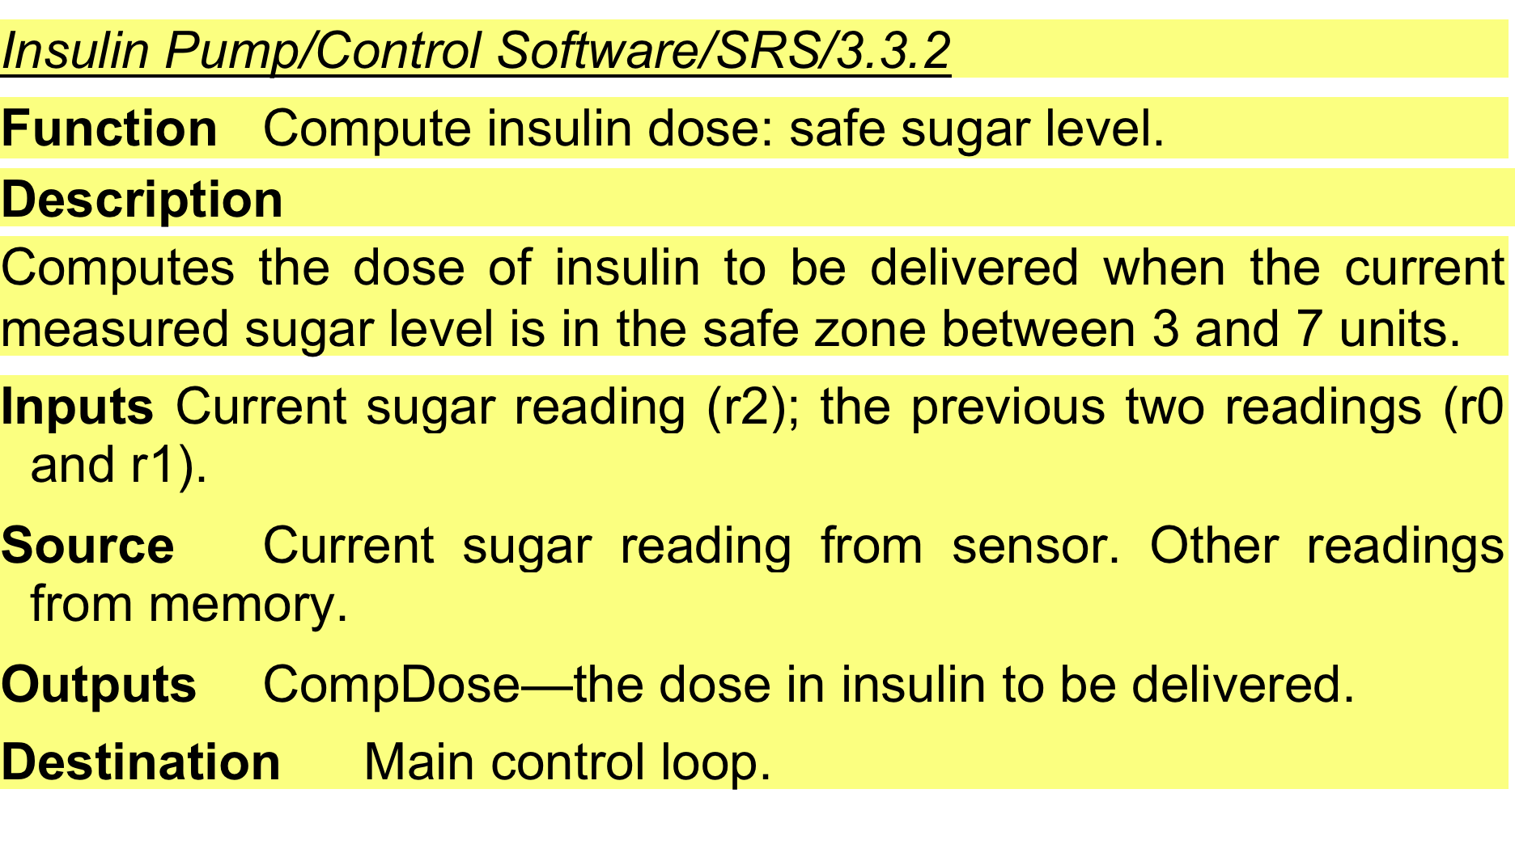
A structured specification of a requirement for an insulin pump

Slide 16
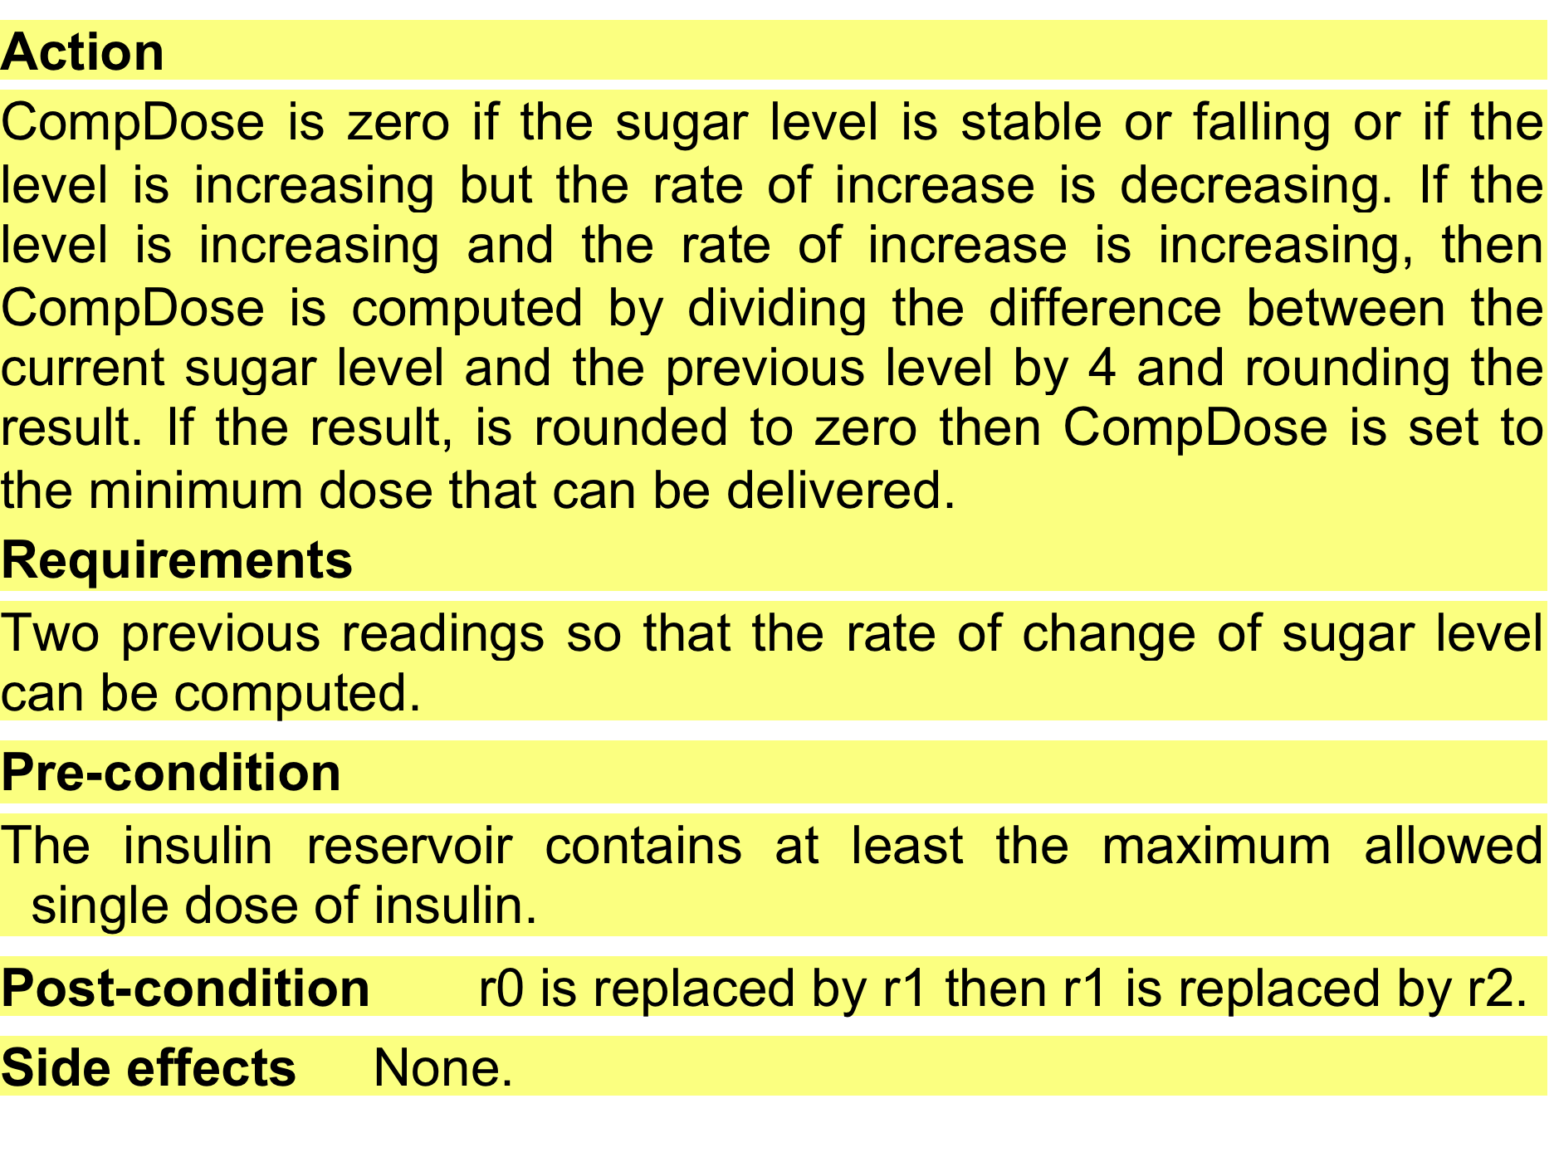
A structured specification of a requirement for an insulin pump

Slide 17
Tabular specification
Used to supplement natural language.
Particularly useful when you have to define a number of possible alternative courses of action.
For example, the insulin pump systems bases its computations on the rate of change of blood sugar level and the tabular specification explains how to calculate the insulin requirement for different scenarios.

Slide 18
Tabular specification of computation for an insulin pump
Condition | Action
Sugar level falling (r2 < r1) | CompDose = 0
Sugar level stable (r2 = r1) | CompDose = 0
Sugar level increasing and rate of increase decreasing ((r2 – r1) < (r1 – r0)) | CompDose = 0
Sugar level increasing and rate of increase stable or increasing ((r2 – r1) ≥ (r1 – r0)) | CompDose = round ((r2 – r1)/4) If rounded result = 0 then CompDose = MinimumDose

